Slide 1
CLINICAL MANIFESTATIONS OF HIV
MBCHB 4

Slide 2
EARLY CLINICAL MANIFESTATIONS --Physical examination at birth may be normal --Initial symptoms- lymphadenopathy, hepatosplenomegaly, nonspecific (chronic/ recurrent diarrhoea, wasting, oral thrush, failure to thrive) --Symptons common in children than adults, include : recurrent bacterial infections, chronic parotid swelling, LIP, early onset of neurologic deterioration.

Slide 3
(CDC)HIV infection Staging: Based on Age-specific CD4+ T-lymphocyte count and Percentage
<1yr
Stage 1: >1500cells/ul (>34%)
Stage 2: 750—1499cells/ul
Stage 3: <750cells/ul ( <26%)
1-5yrs
Stage 1: >1000cells/ul (>30%)
Stage 2: 500—999cells/ul
Stage 3: <500cells/ul (<22%)
>6yrs
Stage 1: >500cells/ul (>26%)
Stage 2: 200—499cells/ul
Stage 3: <200cells/ul (<14%)

Slide 4
WHO STAGING OF HIV FOR INFANTS AND CHILDREN WITH ESTABLISHED HIV INFECTION
Clinical Stage 1
Asymptomatic
Persistent generalized lymphadenopathy
Clinical Stage 2
Unexplained persistent hepatosplenomegaly
Papular pruritic eruptions
Extensive wart virus infection
Extensive molluscum contagiosum
Recurrent oral ulcerations
Unexplained persistent parotid enlargement
Lineal gingival erythema
Herpes zoster
Recurrent or chronic upper respiratory tract infections (otitis media, otorrhoea, sinusitis, tonsillitis)
Fungal nail infections

Slide 5
WHO STAGING
Clinical Stage 3
Unexplained moderate malnutrition not adequately responding to standard therapy
Unexplained persistent diarrhoea (14 days or more)
Unexplained persistent fever (above 37.5 °C, intermittent or constant, for longer than one month)
Persistent oral Candidiasis (after first 6 weeks of life)
Oral hairy leukoplakia
Acute necrotizing ulcerative gingivitis/periodontitis
Lymph node TB
Pulmonary TB

Slide 6
WHO STAGING
Severe recurrent bacterial pneumonia
Symptomatic lymphoid interstitial pneumonitis
Chronic HIV-associated lung disease including bronchiectasis
Unexplained anaemia (<8.0 g/dl), neutropenia (<0.5×109/L³) or chronic thrombocytopenia (<50 × 10⁹/L³)
Clinical Stage 4
Unexplained severe wasting, stunting or severe malnutrition not responding to standard therapy
Pneumocystis pneumonia
Recurrent severe bacterial infections (e.g. empyema, pyomyositis, bone or joint infection, meningitis, but excluding pneumonia)
Chronic herpes simplex infection; (orolabial or cutaneous of more than one month's duration, or visceral at any site)
Extrapulmonary TB

Slide 7
WHO STAGING
Kaposi sarcoma
Oesophageal candidiasis (or candiadisis of trachea, bronchi or lungs)
Central nervous system toxoplasmosis (after the neonatal period)
HIV encephalopathy
Cytomegalovirus (CMV) infection; retinitis or CMV infection affecting another organ, with onset at age more than 1 month
Extrapulmonary cryptococcosis including meningitis
Disseminated endemic mycosis (extrapulmonary histoplasmosis, coccidioidomycosis, penicilliosis)
Chronic cryptosporidiosis (with diarrhoea)
Chronic isosporiasis
Disseminated nontuberculous mycobacterial infection
Cerebral or B cell non-Hodgkin lymphoma
Progressive multifocal leukoencephalopathy
HIV-associated cardiomyopathy or nephropathy

Slide 8
INFECTIONS IN HIV
Bacterial Infections in HIV
Approximately 20% of AIDS-defining illnesses in children are recurrent bacterial infections caused primarily by encapsulated organisms such as Streptococcus pneumoniae and Salmonella as a result of disturbances in humoral immunity.
Other pathogens, include:
Staphylococcus
Enterococcus
Pseudomonas aeruginosa
Haemophilus influenzae
Other Gram-positive and Gram-negative organisms may also be seen

Slide 9
The most common serious infections in HIV-infected children are bacteremia, sepsis, and bacterial pneumonia, accounting for >50% of infections in these patients.
Meningitis, UTIs, deep-seated abscesses, and bone/joint infections occur less frequently.
Milder recurrent infections, such as otitis media, sinusitis, and skin and soft tissue infections, are very common and may be chronic with atypical presentations.

Slide 10
Opportunistic infections in HIV
Generally seen in children with severe depression of the CD4 count.
Young children generally have primary infection and often have a more fulminant course of disease reflecting the lack of prior immunity.

Slide 11
Pneumocystis jiroveci pneumonia(PJP)
most common opportunistic infection in the pediatric population.
peak incidence at age 3-6 mo in the setting of undiagnosed perinatally acquired disease.
highest mortality rate in children <1 yr of age
Aggressive approaches to treatment have improved the outcome substantially, but opportunistic infections still occur in patients with severe immunodepletion as the result of unchecked viral replication, which often accompanies poor cART adherence.

Slide 12
Clinical presentation
acute onset of dyspnea, tachypnea, fever, dry cough, and marked hypoxemia.
Chest X-ray findings(may be normal):
interstitial infiltrates or diffuse alveolar disease (most common), which rapidly progresses.
nodular lesions(occasional)
streaky or lobar infiltrates(occasional)
pleural effusions may occasionally be seen
Diagnosis
demonstration of P. jiroveci with appropriate staining(e.g., GMS, Wright-Giemsa staining) of induced sputum or bronchoalveolar fluid lavage.
Transbronchial biopsy or open lung biopsy(rarely necessary).

Slide 13
Treatment
IV Cotrimoxazole [septrin] (TMP-SMZ) (15-20 mg/kg/day of the TMP component every 6 hr IV)– first line therapy
adjunctive corticosteroids if the Pao2 is <70 mm Hg while breathing room air.
When the patient has improved, therapy with oral TMP-SMZ should be continued for a total of 21 days while the corticosteroids are weaned.
Alternative therapy
IV pentamidine (4 mg/kg/day)
Other regimens(have not been widely used in children to date):
TMP + dapsone
Clindamycin + primaquine/ atovaquone

Slide 14
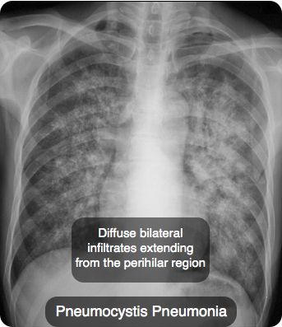
PJP Chest X-rays

Slide 15
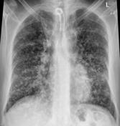
Nodules in PJP

Slide 16
Nontuberculous mycobacterial infection
Caused by Mycobacterium avium-intracellulare complex (MAC).
May cause disseminated disease in HIV-infected children who are severely immunosuppressed.
Incidence of MAC infection in antiretroviral therapy–naïve children with <100 CD4 cells/mm3 is estimated to be as high as 10%.
Effective ART that results in viral suppression makes MAC infections rare.
Clinical presentation of Disseminated MAC
Fever, malaise, weight loss, and night sweats, diarrhea, and abdominal pain.
Rarely: intestinal perforation or jaundice (a result of biliary tract obstruction by lymphadenopathy)

Slide 17
Diagnosis
Culture: Isolation of MAC from blood, bone marrow, or tissue.
NB: the isolated presence of MAC in the stool does not confirm a diagnosis of disseminated MAC.
Treatment
Aim: reduce symptoms and prolong life but is at best only capable of suppressing the infection if severe CD4 depletion persists.

Slide 18
Therapy should include at least 2 drugs:
Clarithromycin (or Azithromycin) + Ethambutol
3rd drug is generally added to decrease the emergence of drug-resistant isolates (rifabutin, rifampin, ciprofloxacin, levofloxacin, or amikacin).
Drug susceptibilities should be ascertained, and the treatment regimen should be adjusted accordingly in the event of inadequate clinical response to therapy.
Because of the great potential for toxicity with most of these medications, surveillance for adverse effects should be ongoing.

Slide 19
Fungal infections in HIV-infected children
Candidiasis
most common fungal infection seen in HIV-infected children.
Treatment for oral candidiasis:
Oral nystatin suspension (2-5 mL qid) is often effective. OR
Clotrimazole troches or fluconazole (3-6 mg/kg PO qid) are an effective alternative.
If oral thrush progresses to involve the esophagus in as many as 20% of children with severe CD4 depletion, they present with: anorexia, dysphagia, vomiting, and fever.
Treatment: oral fluconazole for 7-14 days generally results in rapid improvement in symptoms.
Fungemia rarely occurs, usually in the setting of indwelling venous catheters, and up to 50% of cases may be caused by non–albicans species.

Slide 20
Other fungal infections:
Disseminated histoplasmosis, coccidioidomycosis, and cryptococcosis are rare in pediatric patients but may occur in endemic areas.

Slide 21
Parasitic infections in HIV
Parasitic infections such as intestinal cryptosporidiosis and microsporidiosis, and rarely isosporiasis or giardiasis are other opportunistic infections that cause significant morbidity.
Cause severe chronic diarrhea in HIV-infected children with low CD4 counts, often leading to malnutrition.
Treatment
Immune reconstitution with combination ART (cART) is the most important factor for clearance of the infection.
Nitazoxanide therapy is partially effective at improving cryptosporidia diarrhea.
Albendazole has been reported to be effective against some microsporidia.
Septrin(TMP-SMZ) appears to be effective for isosporiasis.

Slide 22
Viral infections in HIV
Viral infections, especially with the herpes-virus group, pose significant problems for HIV-infected children.
HSV causes recurrent gingivostomatitis, which may be complicated by local and distant cutaneous dissemination.
Primary varicella-zoster virus infection (chickenpox) may be prolonged and complicated by bacterial infections or visceral dissemination, including pneumonitis.
Recurrent, atypical, or chronic episodes of herpes zoster are often debilitating and require prolonged therapy with acyclovir(in case of resistance use Foscarnet).

Slide 23
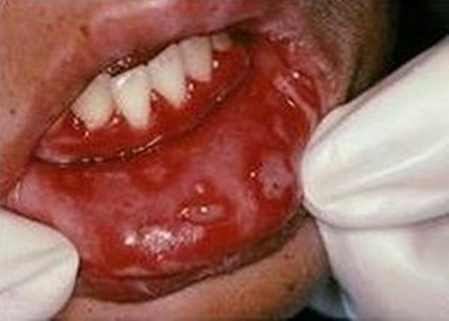
Herpes Gingivostomatitis

Slide 24
Disseminated CMV infection
occurs in the setting of severe CD4 depletion (<50 CD4 cells/μL).
may involve single or multiple organs.
Retinitis, pneumonitis, esophagitis, gastritis with pyloric obstruction, hepatitis, colitis, and encephalitis have been reported.
Complications are rarely seen if cART is given.
Treatment:
Ganciclovir (6 mg/kg bid IV) and foscarnet (60 mg/kg tid IV) are the drugs of choice.
Often given together in children with sight-threatening CMV retinitis.

Slide 25
Measles
may occur despite immunization and may present without the typical rash.
often disseminates to the lung or brain with a high mortality rate.

Slide 26
Respiratory Viruses
Respiratory viruses such as respiratory syncytial virus(RSV) and adenovirus may present with prolonged symptoms and persistent viral shedding.

